Slide 1
Monthly Members Meeting
May 24th, 2022

Slide 2
Welcome!

Slide 3
Agenda
Welcome & Introductions
Announcements
ClientTrack Demo
Equal Access Rule Assessment Tool
Hurricane/ Disaster Preparedness

Slide 4
Equal Access Rule Assessment Tool
Simone Chriss Esq.
Southern Legal Counsel

Slide 5
Equal Access to Housing and Homelessness Services for LGBTQ+ Individuals
A Training for the Homeless Services Network of North Central Florida
Simone Chriss, Esq.
Director of the Transgender Rights Initiative
Southern Legal Counsel

Slide 6
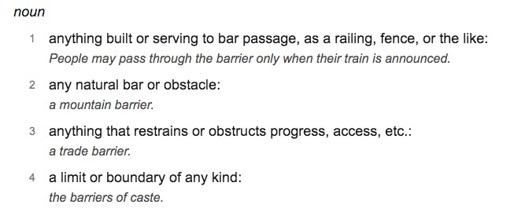
Let’s Talk About Barriers
Source: www.dictionary.com
Some barriers are erected intentionally, or even maliciously, while others are unintentional but require conscious intent to change.
How can we remove barriers to accessing housing and services for LGBTQ+ people?

Slide 7
LGBTQ+ Cultural Competency 101

Slide 8
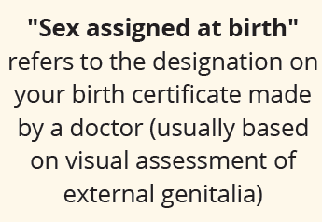
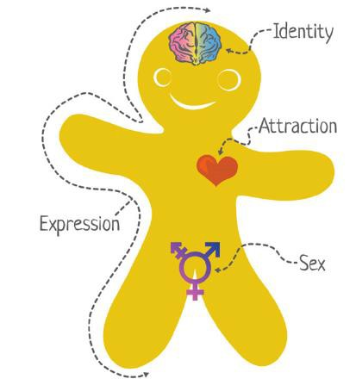
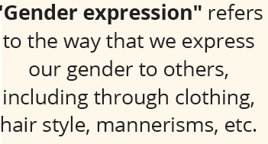
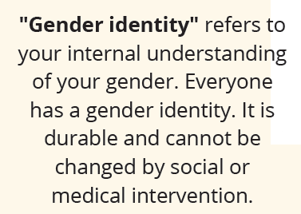
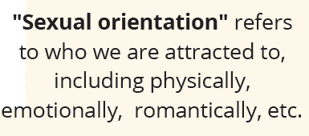

Slide 9
Every individual’s sex is multifaceted and comprised of many distinct biological characteristics, including, but not limited to, chromosomal makeup, hormones, internal and external reproductive organs, secondary sex characteristics, and gender identity.
Everyone has a gender identity!
A person’s gender identity is a fundamental component of their identity that is durable and deeply rooted. It cannot be changed by social or medical intervention.
When a child is born, a sex designation usually occurs at birth based on a visual assessment of the infant’s external genitalia. Most people are cisgender, meaning that their gender identity aligns with the sex they were assigned at birth.
Not everyone’s gender identity aligns with the sex they are assigned at birth. A transgender person is someone who has a gender identity that does not align with their sex assigned at birth.

Slide 10
Transgender
Transgender (trans) is an umbrella term used to describe people whose gender identity and/or gender expression differ from their sex assigned at birth.
This term is an adjective – using it as a verb (i.e. transgendered) or a noun (i.e. transgenders) is incorrect and should be avoided.
TGNC is a common term used to describe the transgender and
gender non-conforming community
Cisgender:
People who are not transgender
Refers to people whose sex assigned at birth corresponds
to their gender identity
Can be any sexual orientation

Slide 11
Gender non-conforming & non-binary
Gender Non-conforming is also a current term that is used to indicate someone who’s biological sex is not congruent with their gender identity or gender expression.
Terms you may also hear: genderqueer, gender fluid, gender variant, etc.
Non-binary: One term used by individuals who do not feel that they fit into one of the two categories on the gender binary, male or female. Often use “they/them” pronouns. Some non-binary individuals also identify as transgender, but not all do.

Slide 12
Coming Out
The process of disclosing one’s sexual orientation or gender identity to others.
Because most people in our society are presumed to be heterosexual and cisgender, coming out is not a one-time life event; it is a lifelong process that is continuously repeated.
Heterosexual and cisgender family members or allies of LGBT persons may also experience a coming out of their own, when and if they decide to disclose to others that they have friends or relatives who are LGBT.

Slide 13
Gender Dysphoria
Gender dysphoria refers to discomfort or distress that is caused by a discrepancy between a person’s gender identity and that person’s sex assigned at birth (and the associated gender role and/or primary and secondary sex characteristics). This is a formal diagnosis in the DSM-V.
Being transgender is not a disorder, rather the distress of dysphoria (i.e. levels of anxiety, depression, psychological distress etc. often accompanying being trans) can rise to the level of a diagnosable disorder for which treatment is available.
Diagnosis is not a license to stigmatize, discriminate, or deny civil
rights.
Only some transgender people experience gender dysphoria.
The diagnosis debate.

Slide 14
Heterosexual Privileges
Kissing, hugging, or being affectionate in public without fear
Raising children without the fear that they will face discrimination or rejection
Having grown up with positive TV role models
Receiving validation from your religious community
Being able to visit your partner in the hospital after an
accident
Until very recently:
Celebrating your marriage with your family, friends, and coworkers.
Inheriting from your partner after their death.
Filing joint tax returns, having your partner on your health insurance, etc.

Slide 15
Cisgender Privileges
Use public restrooms without fear of verbal abuse, physical intimidation, or arrest.
Use public facilities such as gym locker rooms and store changing rooms without stares, fear, or anxiety.
Strangers don’t assume they can ask you what your genitals look like and how you have sex.
Your validity as a man/woman/human is not based on how much surgery you’ve had or how well you “pass” as non-transgender.
Not needing the Court or legislature to decide what
bathroom you’re allowed to use, whether you’re allowed to play sports, whether your driver’s license reflects who you are, whether you can be fired for who you are, etc.

Slide 16
Florida’s LGBT Population
Florida has the third highest number of identified transgender people, and has among the highest numbers of LGB people as well, according to the Williams Institute.
Yet, we lack statewide protection for LGBT individuals from
discrimination in housing, employment, and public accommodations.
There are approximately 663,000 LGBTQ adults and
100,000 LGBTQ youth in the state of Florida
There are approximately 100,300 transgender adults and
9,050 transgender minors in the state of Florida.

Slide 17
Intersection of Poverty
90% of transgender people experience harassment, discrimination, and mistreatment at work.
29% of the transgender population lives in poverty, 2x the national average.
The unemployment rate among the transgender population is 15%, 3x national average.
40% of trans individuals have attempted suicide in their lifetime, 9x the national average (4.6%)
NCTE U.S. Transgender Survey

Slide 18
Individuals Experiencing Homelessness
Nearly one-third, 30%, of the transgender individuals report experiencing
homelessness.
Among transgender individuals seeking emergency shelter:
29% were turned away altogether (one in three people)
42% were forced to stay in shelters in accordance with their sex assigned
at birth
55% of those trying to access a homeless shelter were harassed by staff or residents
22% were sexually assaulted by residents or staff
47% who accessed shelters left because of the treatment they received
there
A HUD survey found that transgender testers who disclosed that they were trans were 11% less likely to be told that there were any units available, and providers told gay men and transgender testers about fewer units than they told cisgender and heterosexual home seekers.
Nearly 40% of homeless youth identify as LGBTQ.

Slide 19
Individuals Experiencing Homelessness
2020 HUD Point-In-Time-Count data showed that between 2016 and 2019, the number of homeless transgender people in the
U.S. increased 88%.
The number of adult transgender individuals experiencing unsheltered homelessness increased 113 percent during the same period.
One in five transgender people in the United States has been discriminated when seeking a home, and more than one in ten have been evicted from their homes, because of their gender identity.

Slide 20
Individuals Experiencing Homelessness
39% of LGBTQ youth in care were forced to leave their home because of their sexual orientation or gender identity
Over 30% of LGBTQ youth reported suffering physical violence at the hands of a family member after coming out
Devastatingly, 78% of these youth then endure further harassment or abuse
after being placed in out-of-home care
70% of LGBTQ youth in group homes reported violence based on their LGBTQ status
Nearly 80% of LGBTQ youth surveyed in one study were removed or ran away from their foster placements as a result of hostility toward their sexual orientation or gender identity.
In a survey by the Center for American Progress across 4 states, only 30% of shelters correctly offered shelter to test callers identified as transgender.
U.S. Dept. of Health & Human Servs., Admin on Children, Youth & Families, Information Memorandum ACYF-CB-IM-11-03, Lesbian,
Gay, Bisexual, Transgender and Questioning Youth in Foster Care and National Center for Transgender Equality

Slide 21
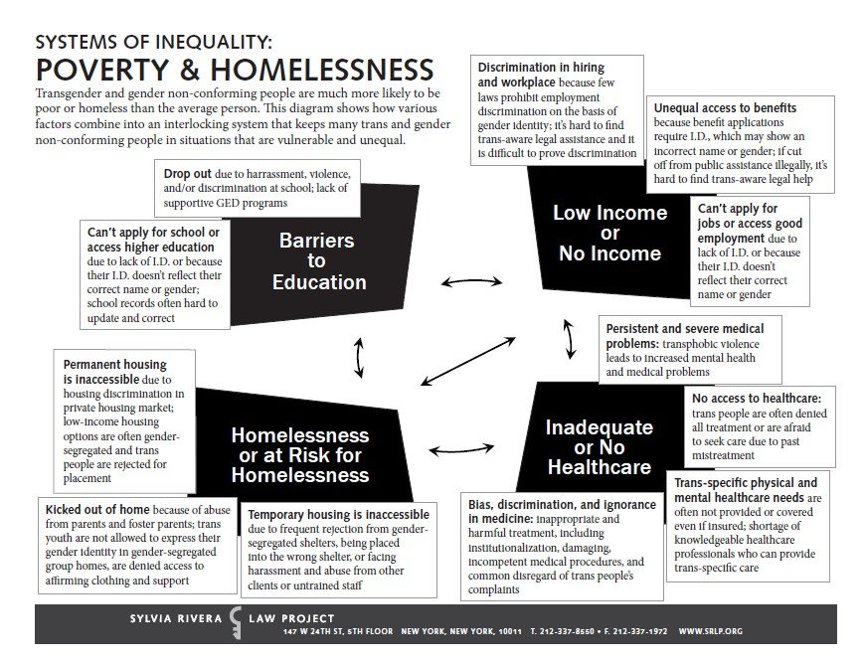

Slide 22
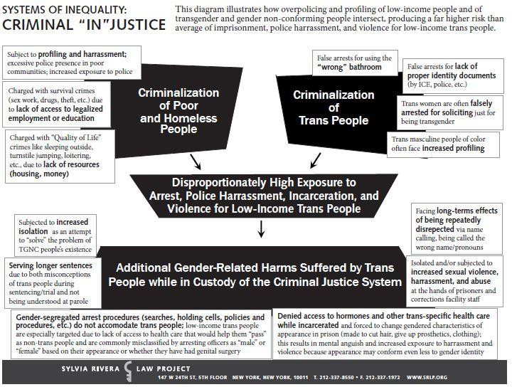

Slide 23
Intersectionality
"The complex, cumulative way in which the effects of multiple forms of discrimination (such as racism, sexism, and classism) combine, overlap, or intersect, especially in the experiences of marginalized individuals or groups."
— Merriam-Webster Dictionary
RACE
SEXUAL ORIENTATION
GENDER IDENTITY
DISABILITY
NATIONALITY

Slide 24
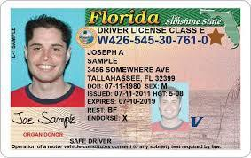
The Importance of Accurate ID
Secure housing
Access emergency shelter
Obtain employment
Apply for public benefits
Buy a drink or enter a club
Rent a car or a hotel room
Traffic stop by police
Cash a check
Board an airplane
Most trans individuals have not updated any of their identification documents to reflect their name and gender identity. Why is this?

Slide 25
Name and Gender Marker Change: Basic Overview
Legal court order for name change:
Fill out petition, accompanying forms, have notarized, file
Pay $400 filing fee (or request filing fee waiver)
Get fingerprinted for background check (~ $36-$56 fee)
Request hearing from clerk of court
Appear before a judge in a court hearing (most on zoom now)
This does not automatically update legal name, must use court order for name change to update each document
Identification documents (SS, Drivers License, Passport, Birth Certificate):
Must amend each document individually
Must have court order for name change
Must have physicians’ letter stating that you’ve undergone “appropriate
clinical treatment” for gender transition
Complete the various applications and affidavits for each government agency with whom you want to change name/gender marker
Associated filing fees

Slide 26
Obstacles and Barriers to Obtaining Legal Authenticity
Lack of financial resources needed to obtain fingerprints for background check, to obtain certified copies of the order, to update driver’s license & birth certificate, and more;
Lack of access to transportation to get to courthouse, fingerprinting appointment, hearing, etc.;
Lack of support from parent(s) for minor’s seeking name change, as
parent must be “petitioner” for minor child;
Functional literacy issues in filling out the forms and following the procedural instructions;
Limited access to internet (and difficulty finding forms if no access to
Florida Name Change);
Access to affirming medical care/affirming physician, as a letter is required to obtain a gender marker change on government-issued documents (also access to health insurance);
The fear of “outing” oneself in open court during the hearing, particularly in small and rural counties.

Slide 27
Importance of Legal Authenticity
Access to legal identification documents is a structural intervention for establishing economic stability for transgender individuals, given the central role ID documents play in obtaining employment, housing, public assistance, healthcare, and more.
Recent groundbreaking studies on the powerful effects of legal
authenticity for trans individuals demonstrated:
Among women of color, those who had obtained a legal name change were 5x more likely to make above $1,000 per month, and 3x more likely to rent an apartment or home;
Gender-concordant IDs → marked decreases in depression, suicidal ideation, suicidal behavior, and serious psychological distress.
For transgender youth in particular, legal authenticity (updated birth certificate) can be key to an affirming school environment.

Slide 28
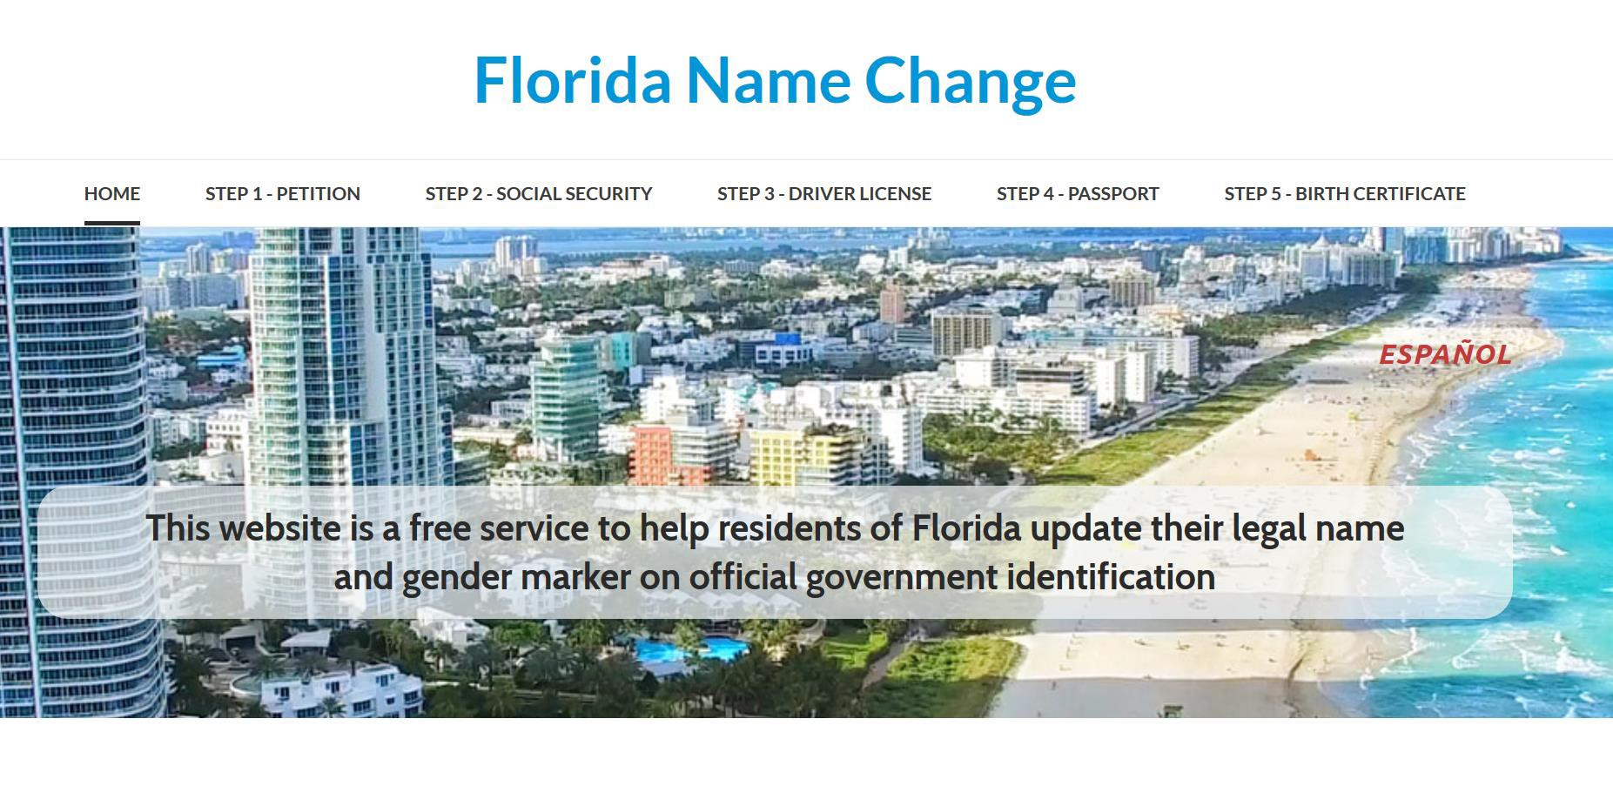

Slide 29
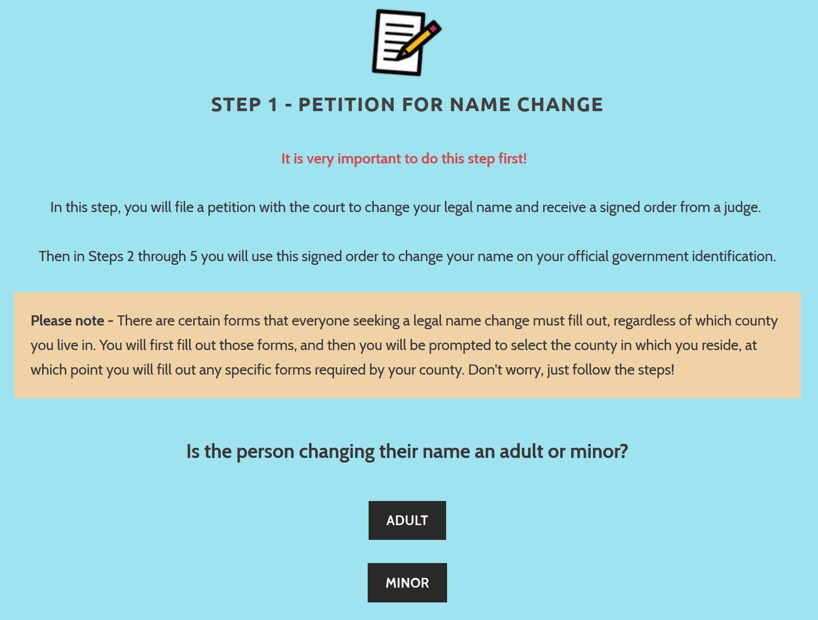

Slide 30
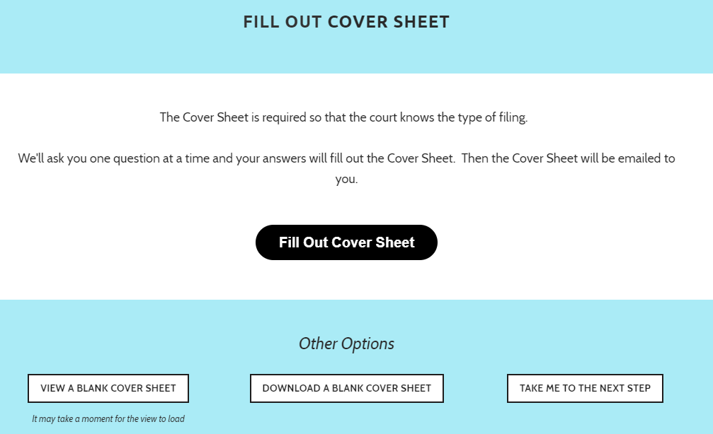

Slide 31
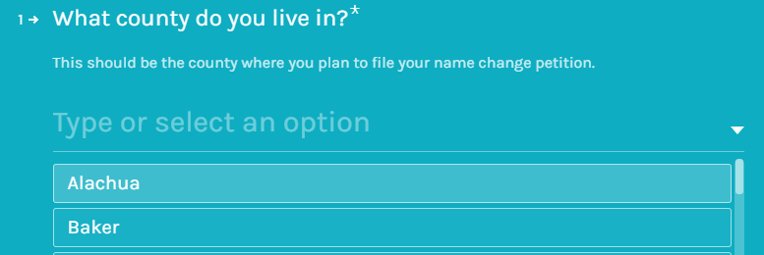

Slide 32
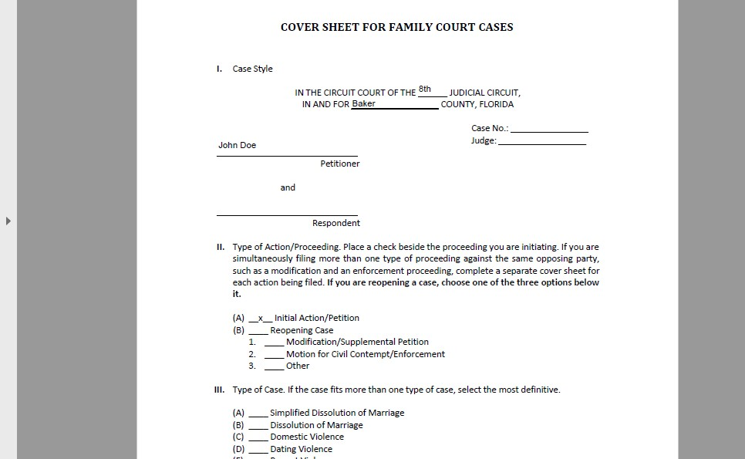

Slide 33
Best Practices
Introduce yourself with your pronouns
Demonstrate inclusivity
Inclusive intake forms (use affirmed name only)
Avoid gendered greetings (Ms. and Mr., sir and ma’am, etc.) and opt for inclusive non-gendered terms (caller, client, student, parent, etc.)
Welcoming office (or zoom) environment
Inclusive/affirming language demonstrates allyship and creates a safe space, but language can also do the opposite.

Slide 34
The Equal Access Rules: Legal Obligations

Slide 35
HUD Equal Access Timeline
February 3, 2012
HUD published a final rule entitled “Equal Access to
February 11, 2021
June 15, 2020
Supreme Court issues Bostock v. Clayton County, Georgia opinion, holding “sex” discrimination includes sexual orientation and transgender status
HUD issued memorandum
entitled, “Implementation of
Housing in Regardless Orientation
HUD Programs of Sexual
or Gender
Executive Order 13988 on the Enforcement of the Fair Housing
Act” which announced new LGBTQI+ protections under the Fair Housing Act.
Identity” (2012 Equal Access
Rule)
September 21, 2016
HUD published a final rule
January 20, 2021
President Executive Preventing
Biden Order and
issued
13988,
entitled "Equal Access in Accordance with an Individual's Gender Identity in Community Planning and Development Programs” (2016 Equal Access Rule)
Combating
Discrimination on the Basis of Gender Identity or Sexual Orientation

Slide 36
2012 Equal Access Rule
Published in the Federal Register / Vol. 77, No. 23 / Friday, February 3, 2012
Accessible at: https://www.govinfo.gov/content/pkg/FR-2012-02-03/pdf/2012- 2343.pdf
2016 Equal Access Rule
Published in the Federal Register /Vol. 81, No. 183 /Wednesday, September 21, 2016
Accessible at: https://www.federalregister.gov/documents/2016/09/21/2016- 22589/equal-access-inaccordance-with-an-individuals-gender-identity-in-community- planning-and-development

Slide 37
The Equal Access Rules
WHY: In 2011, HUD investigated and found evidence suggesting that LGBTQ+ individuals and families were being arbitrarily excluded from housing opportunities in the private sector. Further, LGBTQ+ people were disproportionately more likely to experience homelessness.
HUD issues 2012 Equal Access Rule to ensure that its core programs are open to all eligible individuals and families regardless of sexual orientation, gender identity, or marital status/family composition. HUD builds upon these non-discrimination protections in publishing the 2016 Equal Access Rule.
These rules prohibit inquiries regarding sexual orientation or gender identity
These rules makes clear that families, who are otherwise eligible for HUD programs, may not be excluded because one or more members of the family may be LGBTQ+ or perceived to be LGBTQ+
It is unlawful sex discrimination for any landlord or housing provider to deny housing because of someone's actual or perceived HIV/AIDS status under the Fair Housing Act (or the EAR if a HUD assisted or insured housing program) if based on a housing provider’s stereotyping of LGBTQI+ individuals.
It is unlawful for HUD-assisted facilities to segregate or isolate transgender individuals
based on their sex assigned at birth

Slide 38
The Equal Access Rules
Housing providers and homeless service providers that receive HUD funding or have FHA loans are subject to HUD’s Equal Access Rules which require equal access to HUD’s programs without regard to a person’s gender identity.
No requirement to provide proof of gender.
Family is defined without reference to sexual orientation.
Providers must update policies and procedures
to reflect requirements.

Slide 39
Emergency Shelters
Providers may not deny access to a single-sex emergency shelter or facility because the identification documents indicate a gender marker that is different from a person’s gender identity (or segregate or isolate that person)
A provider may not consider a person ineligible for an emergency shelter or other facility because their appearance or behavior does not conform to gender stereotypes
Providers may not ask or seek documentation concerning medical history or a person’s anatomy

Slide 40
Placement Eligibility
You should place potential clients in the facility that corresponds to their gender identity
OR
If an individual feels the need to be placed in a facility that does not correspond with their gender identity for health and safety reasons, you should accommodate that request.
It’s really important to understand that you should take non- discriminatory steps to address a clients’ privacy concerns, but don’t have a blanket policy of treating transgender people differently. If they raise a privacy concern, then accommodate. Don’t put them in a separate single room unless the request that for their safety.

Slide 41
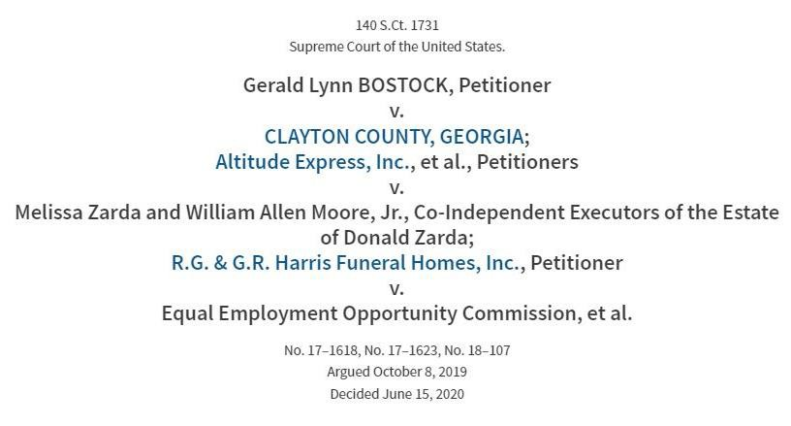
In 2020, in Bostock v. Clayton County, the Supreme Court held that Title VII of the Civil Rights Act of 1964’s prohibition on discrimination “because of…sex” includes discrimination on the basis of gender identity and sexual orientation.
Though Bostock was an employment law case, it is a landmark case for fair housing law because FHA’s sex discrimination provisions are comparable in text and purpose to those of Title VII.

Slide 42
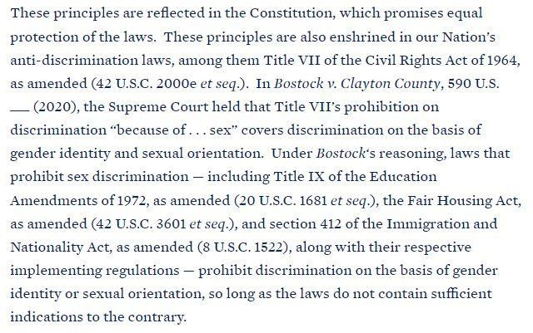

Slide 43
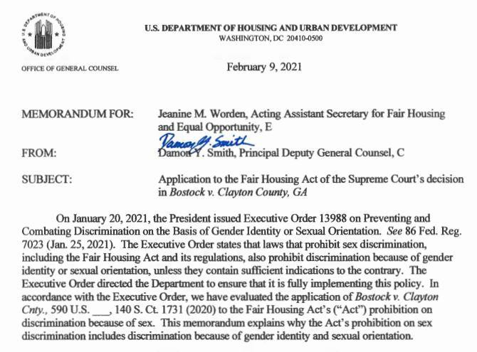

Slide 44
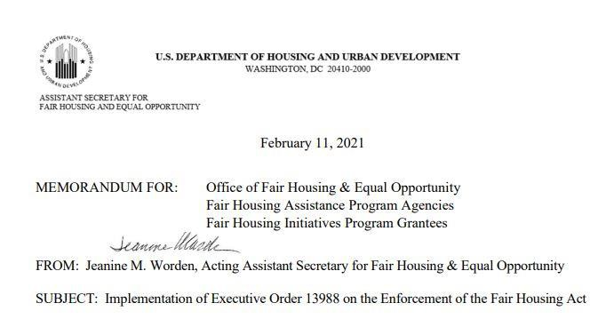

Slide 45
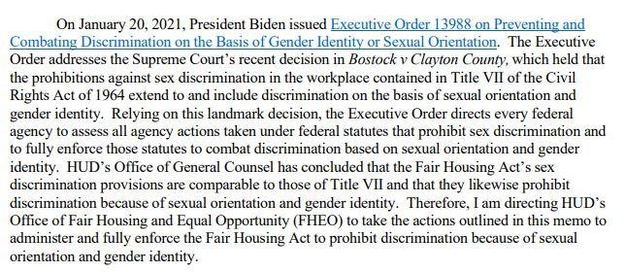

Slide 46
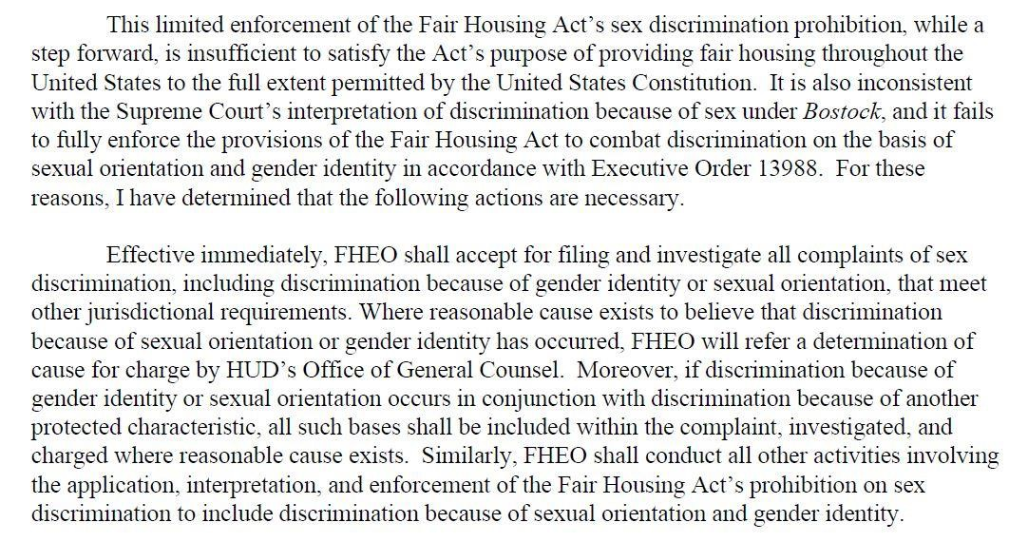

Slide 47
What does discrimination look like?
A transgender female tenant (who was assigned the sex male at birth) is asked not to dress in feminine or other gender non- conforming clothing in the common areas of the property or shelter
After meeting the same-sex partner of a resident, the resident is asked to leave or removed from the program
A transgender man sought housing at a HUD-funded men’s homeless shelter and during the intake process the shelter staff refused to address him as male, misgendered him, and made other statements to discredit his gender identity
Shelter staff refused to shelter a transgender woman at the women’s facility but offered to place her in a men’s shelter or in isolation

Slide 48
Supporting Equal Access Across the Full Spectrum of Services
Outreach and engagement
Assessment
Referral
Enrollment
Unit and bed assignment
Ongoing service provision

Slide 49
HUD Equal Access Agency Assessment Tool

Slide 50
Agency Assessment Tool
This Equal Access Agency Assessment Tool provides specific action steps for HUD recipients and sub- recipients to meet the requirements of the Equal Access Rule in shelters and other facility settings. This tool is for agencies’ internal use only. This tool is intended for administrative staff, however, front line staff may also benefit from reading the tool and assisting in the assessment process.
This is a companion tool to the Equal Access Guide for Transgender People: Supporting Inclusive Housing and Shelters and the Equal Access Training Scenarios

Slide 51
Anti-Discrimination Policy/Notice
Adopt anti-discrimination policy that applies across CoC
All programs and services provided through CoC should revise their own anti-discrimination policies
Individuals accessing programs or services should be provided with notice of compliance of equal access rule, including by posting signs in places where information is made available (sample)
Best Practices Tip: Have Clients sign Non- discrimination policy to set expectations (sample)

Slide 52
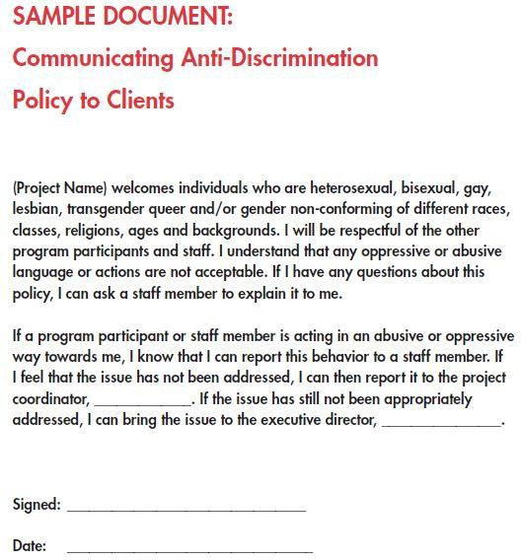
Developed by HUD – Equal Access Expectations Toolkit

Slide 53
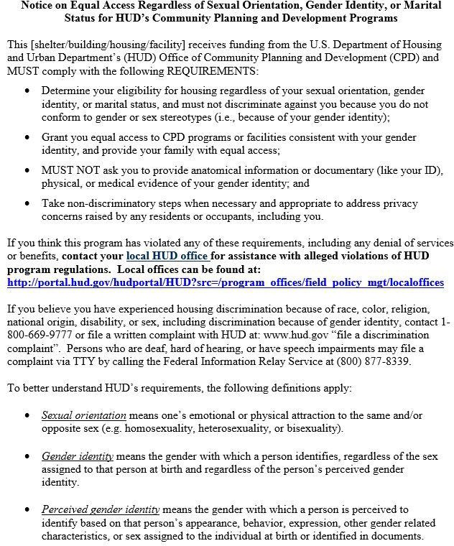

Slide 54
Inclusive Language
Make anti-discrimination policy and notice publically available on agency’s or CoC’s website
Use appropriate, inclusive language in ALL communications, publications, trainings, personnel handbooks, and other policy documents

Slide 55
Now I will pull up the HUD Equal Access Agency Assessment Tool

Slide 56
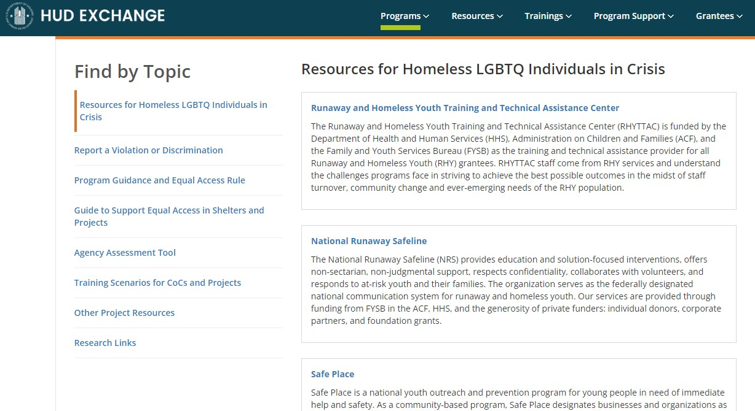
RESOURCES: HUD Exchange
https://www.hudexchange.info/homelessness-assistance/resources-for-lgbt- homelessness/#resources-for-homeless-lgbtq-individuals-in-crisis
Also check out the Fair Housing and Equal Opportunity (FEHO) Resources for LGBTQ+ individuals:
FEHO Resources on LGBTQ+

Slide 57
RESOURCES
2012 Equal Access Rule:
https://www.govinfo.gov/content/pkg/FR-2012-02-03/pdf/2012- 2343.pdf
2016 Equal Access Rule: https://www.federalregister.gov/documents/2016/09/21/2016- 22589/equal-access-inaccordance-with-an-individuals-gender- identity-in-community-planning-and-development
Agency Assessment Tool: https://www.hudexchange.info/resource/4952/equal-access-rule- project-self-assessment-tool/
Equal Access for Transgender People: Supporting Inclusive Housing and Shelters: https://www.hudexchange.info/resource/4959/equal-access-for- transgender-people-supporting-inclusive-housing-and-shelters/
Equal Access Expectations: Training Scenarios for Use with Project Staff: https://www.hudexchange.info/resource/4951/equal-access-staff- training-scenarios/

Slide 58
RESOURCES
June 2020, Bostock v. Clayton County, GA (Supreme Court Opinion holding “discrimination on the basis of sex” includes discrimination on the basis of sexual orientation and gender identity): https://www.supremecourt.gov/opinions/19pdf/17-1618_hfci.pdf
January 20, 2021 Executive Order on Preventing and Combating Discrimination on the Basis of Gender Identity or Sexual Orientation: https://www.whitehouse.gov/briefing-room/presidential- actions/2021/01/20/executive-order-preventing-and-combating- discrimination-on-basis-of-gender-identity-or-sexual-orientation/
February 9, 2021 HUD Memorandum re Application to the Fair Housing Act of the Supreme Court's decision in Bostock v. Clayton County, GA: https://www.hud.gov/sites/dfiles/ENF/documents/Bostock%20Legal%2 0Memorandum%2002-09-2021.pdf
February 11, 2021 HUD Memo re Implementation of Executive Order 13988 on the Enforcement of the Fair Housing Act: https://www.hud.gov/sites/dfiles/PA/documents/HUD_Memo_EO1398 8.pdf

Slide 59
QUESTIONS?

Slide 60
SLC is a Florida statewide not-for-profit legal and policy advocacy organization that is committed to the ideal of equal justice for all and the attainment of basic human and civil rights.
Simone Chriss
Director of Transgender Rights Initiative Southern Legal Counsel simone.chriss@southernlegal.org
Located at 1229 NW 12th Ave. Gainesville, Fl. 32601
Our office can be reached at (352) 271-8890

Slide 61
Client Track Demo
Brittney Behr
HSN, HMIS Project Coordinator

Slide 62
2022 Hurricane Season & Disaster Preparedness
Christopher Fowler

Slide 63
Disaster preparedness
Hurricane season starts on June 1st!
Preparedness begins with you!
3 Steps to Preparedness
Have a Plan
Build a Kit
Stay Informed
Notes:
National Oceanic and Atmospheric Administration
They will be releasing their predictions later today, we’ll learn more about that next month
Manuel D. Soto, CEM
Emergency Manager

Slide 64
Have a plan in place
Individual Preparedness
Keep your plan simple.
Determine your risk
Keep copies of the plan in several places (home, work, kit, etc)
Practice your emergency plan with family members at least twice a year.
Consider your households specific needs
Plan for pets/service animals.
Remember – Disaster can happen anytime!
Notes:
Determine Your Risk:
Find out today what types of wind and water hazards could happen where you live
Hurricanes are not just a coastal problem. impacts from wind and water can be felt hundreds of miles inland,
Know if you live in an area prone to flooding, tornados, and if you’re safe to remain in your home.
Disaster can happen anytime!

Slide 65
Organizational Preparedness
Check out our Disaster Prep Guide
https://bit.ly/DisasterPreparednessFL-507
Our disaster preparedness guide includes
Organizational Preparedness Guide
COC FL-507’s Disaster Communication Plan
Hurricane Preparedness Checklist for Organizations
Hurricane Preparedness Resources
Disaster Preparedness Plan Template

Slide 66
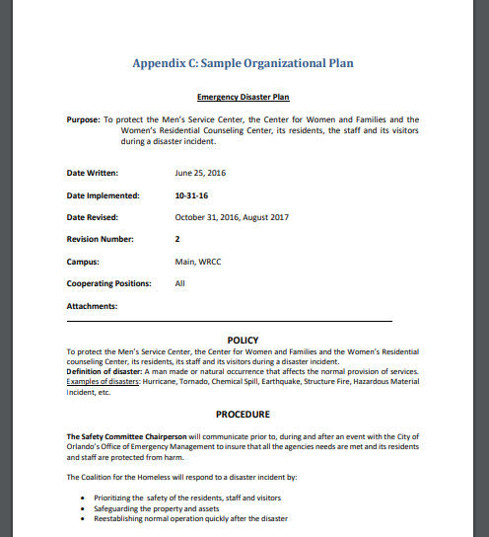
Disaster Preparedness Plan Template
Notes:
Includes sample procedures,
employee or departmental responsibilities,
COMMUNITY CONTACTS
Use this template and tailor it to your organization’s needs

Slide 67
Build a disaster kit
Water – 1 gallon per person per day for 3 to 7 days
Food – for at least 3 – 7 days
First Aid Kit / Medicines/ Prescriptions
Special Items – for babies and elderly
Toiletries
Flashlight / Batteries
Battery-powered Radio
NOAA WX Radio
Important Documents
Pet care Items
Notes:
For Organizations:
This list might also include items such as: Sanitation & Hygiene Items, Blankets or sleeping bags, masks,

Slide 68
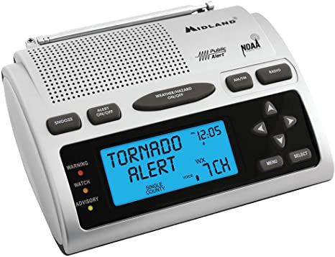
Stay informed
Be sure to watch local news coverage of official press conferences.
For Storm Forecasts, visit https://www.nhc.noaa.gov/
Follow NWS Melbourne on Twitter!
@NWSMelbourne, https://twitter.com/NWSMelbourne
https://www.weather.gov/mlb/
Purchase a NOAA Weather Alert Radio.
Notes:
LE/Fire train together
Regional Exercises
Annual EOC TTX Training at Executive Level and our ESFs

Slide 69
Stay informed
Seminole County
https://www.seminolecountyfl.gov/departments-services/county-managers-office/prepare-seminole/
Orange County
https://www.orangecountyfl.net/EmergencySafety/EmergencyInformation.aspx#.YKv8AahKgUF
Osceola County
https://www.osceola.org/agencies-departments/emergency-management/
Notes:
LE/Fire train together
Regional Exercises
Annual EOC TTX Training at Executive Level and our ESFs

Slide 70
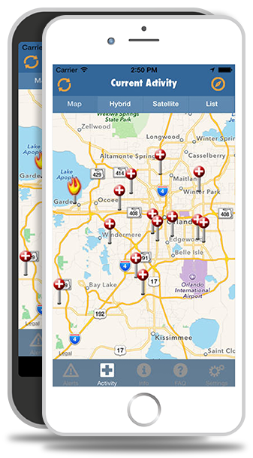
Stay informed
Sign up for a text-based emergency notification system.
https://www.floridadisaster.org/alertflorida/
Register for your county!
Seminole: https://member.everbridge.net/index/892807736724714
Orange: https://member.everbridge.net/index/892807736724714
Osceola: https://member.everbridge.net/453003085614910
Notes:
LE/Fire train together
Regional Exercises
Annual EOC TTX Training at Executive Level and our ESFs

Slide 71
Reminder
Review
Review plan (annually) & rotate items in kit every (6 months)
Check
Check all perishable items:
batteries,
food,
water,
medicines (over-counter)
Conduct
Conduct emergency drill annually

Slide 72
Announcements!

Slide 73
HUD and ACF Funding Opportunity For Youth Experiencing Homelessness or Housing Instability
HUD and the Family and Youth Services Bureau (FYSB), within the U.S. Department of Health and Human Services’ Administration for Children and Families (ACF) announced the newly released NOFO for communities and organizations to build and expand housing and services for youth experiencing homelessness.
In April 2022 FYSB released four NOFOs to support youth and young adults who are experiencing homelessness or housing instability
FY 2022 Basic Center Program (BCP) NOFO to provide emergency shelter and services to youth under 18 years of age who have left home without permission of their parents or guardians, been forced to leave home, or are experiencing homelessness for up to 21 days
FY 2022 Transitional Living Program (TLP) NOFO to provide up to 22 months of housing and services for youth and young adults ages 16 to under 22
FY 2022 Maternity Group Home (MGH) NOFO to provide up to 22 months of housing and services for pregnant and/or parenting youth and young adults ages 16 to under 22 and their dependent children
FY 2022 Street Outreach Program (SOP) NOFO to provide street outreach services to youth experiencing homelessness or housing instability, who have left home, and are sleeping on the street or are at-risk of sexual abuse, sexual exploitation, and human trafficking

Slide 74
Congratulations!
Richard Wang, Program Director at Wayne Densch Center, was awarded Social Work Intern Supervisor of the Year by the School of Social Work at UCF

Slide 75
Need PPE?
Let HSN meet your PPE needs!
Reusable and Disposable Masks
Hand Sanitizer
Gloves
Need any? Let us know!
Contact Christopher.Fowler@hsncfl.org to arrange a pickup

Slide 76
Next Meeting
Tuesday, May 24th, 2022
9 to 10:30 am
Location: Online

